Slide 1
MIST_PotatoChips
Members:
Nawreen Anan Khandaker
Fairooz Nawar Nawme
Mahapara Naim
Ramiza Rumaisa Aliya

Slide 2
Problem Statement & Solution:
Kid’s obsession with playing games on mobile phones for hours.
Utilizing this addiction to help them learn basic mathematical operations.

Slide 3
MathRun - “Run and Learn”:
A game to make the kids learn simple digits, addition, subtraction, multiplication, and division.
User has to collect coins while avoiding obstacles.
Failing to avoid an obstacle leads to a pop up.
Right answer will continue the game, otherwise game over.

Slide 4
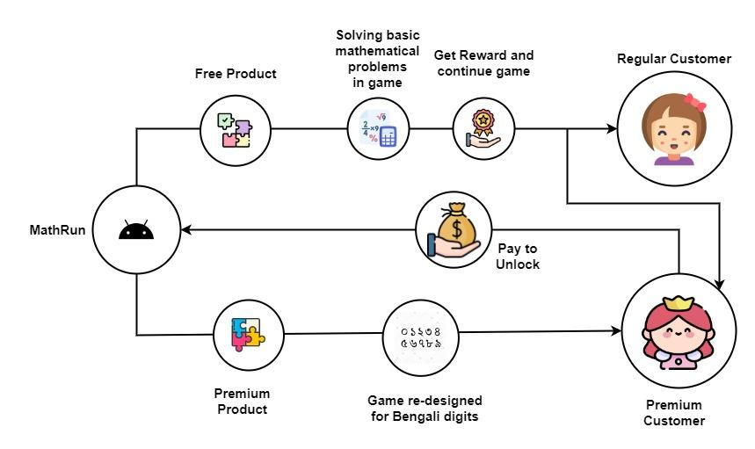
Business Model:Freemium Model for MathRun

Slide 5
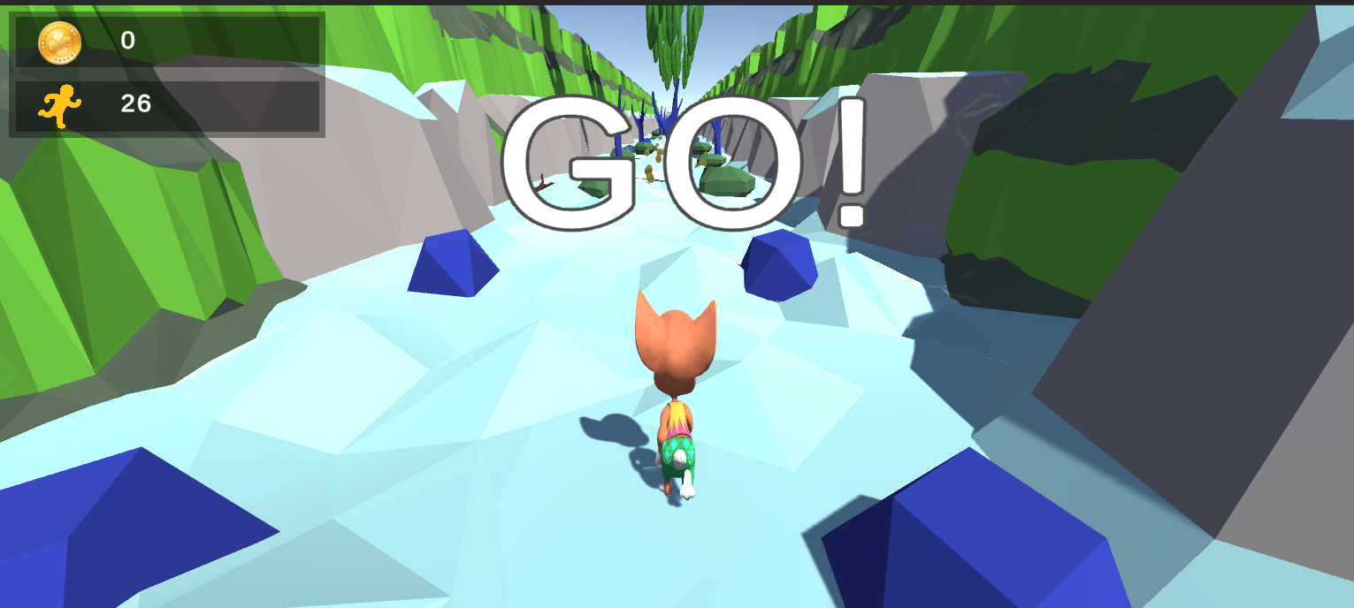
MathRun UI Snapshots:

Slide 6
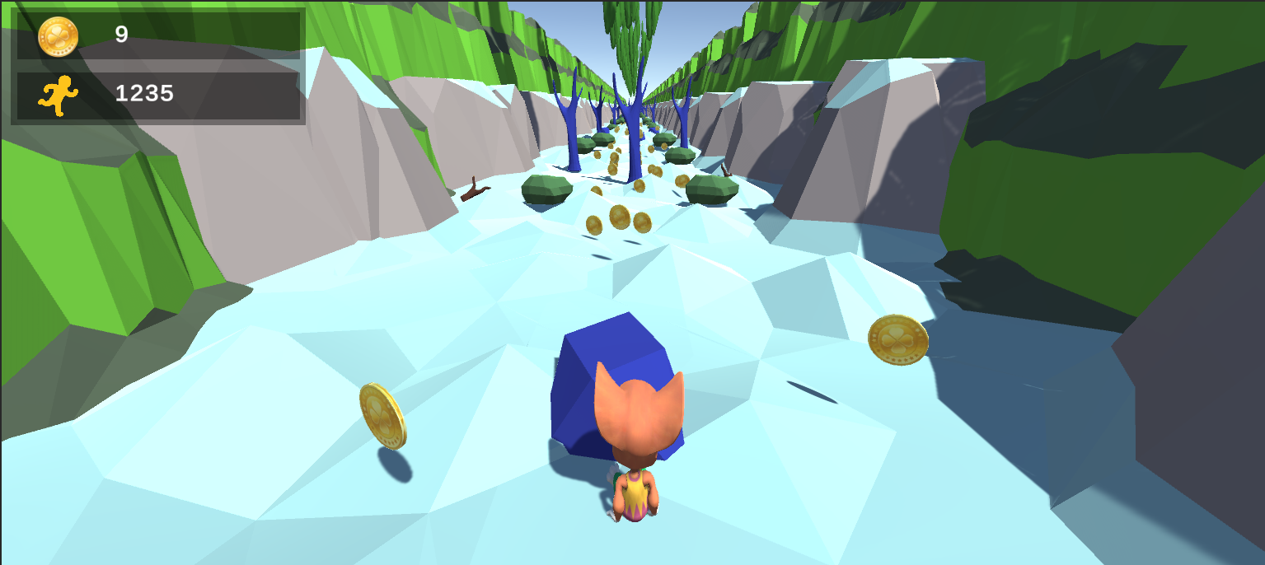

Slide 7
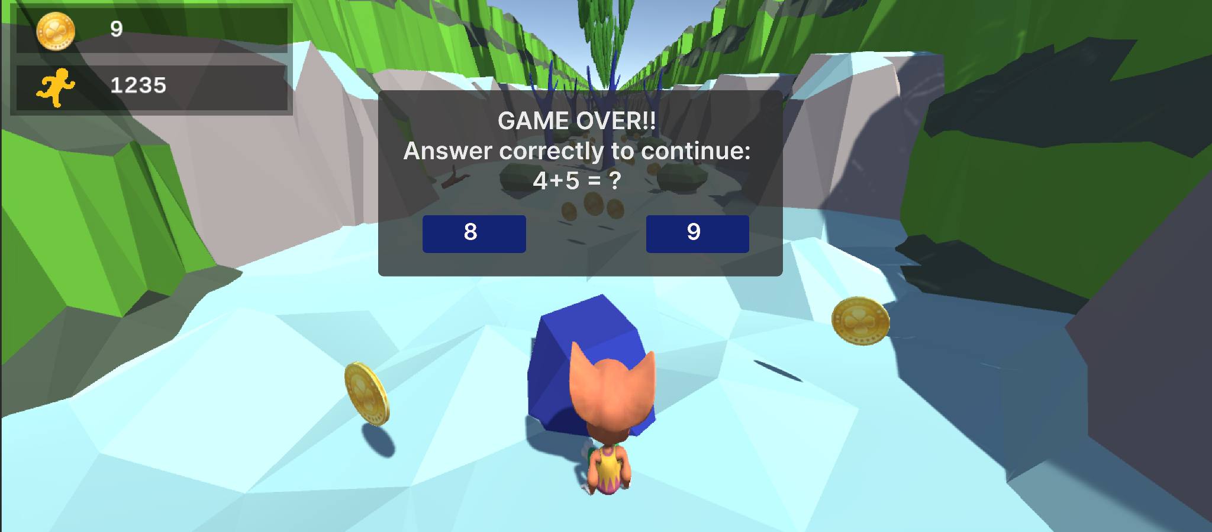

Slide 8
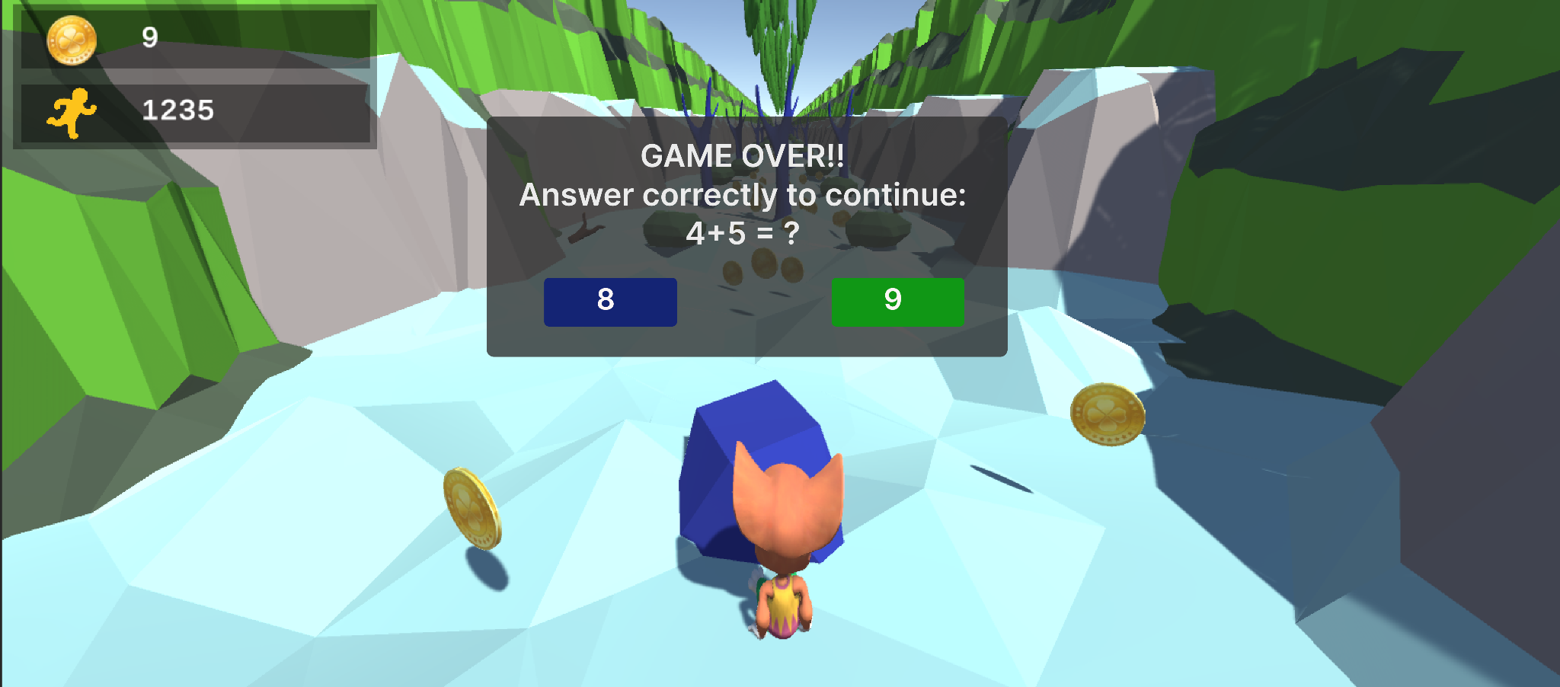

Slide 9
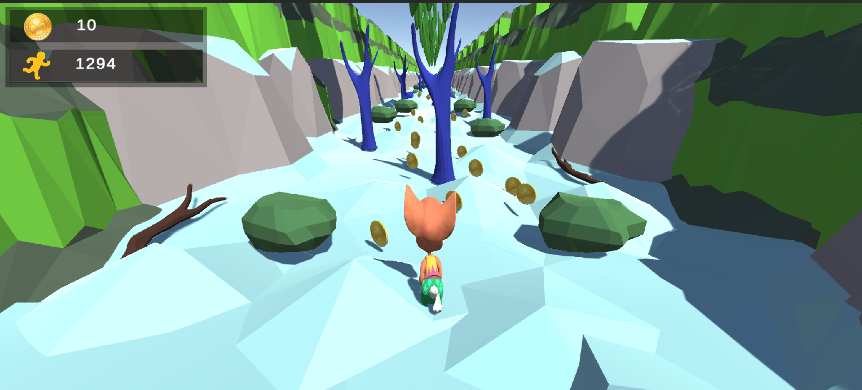

Slide 10
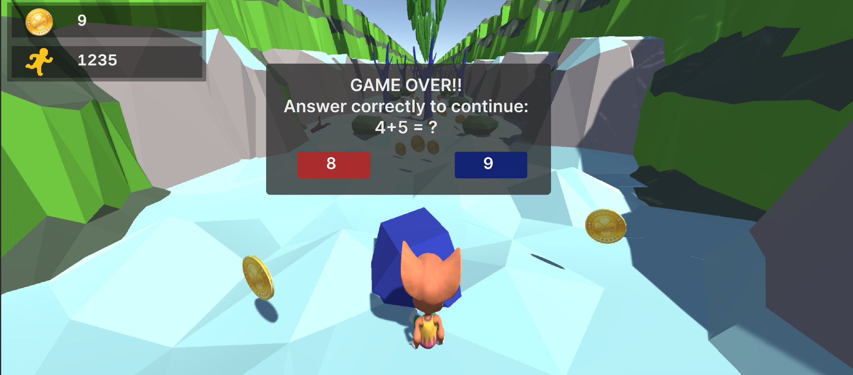

Slide 11
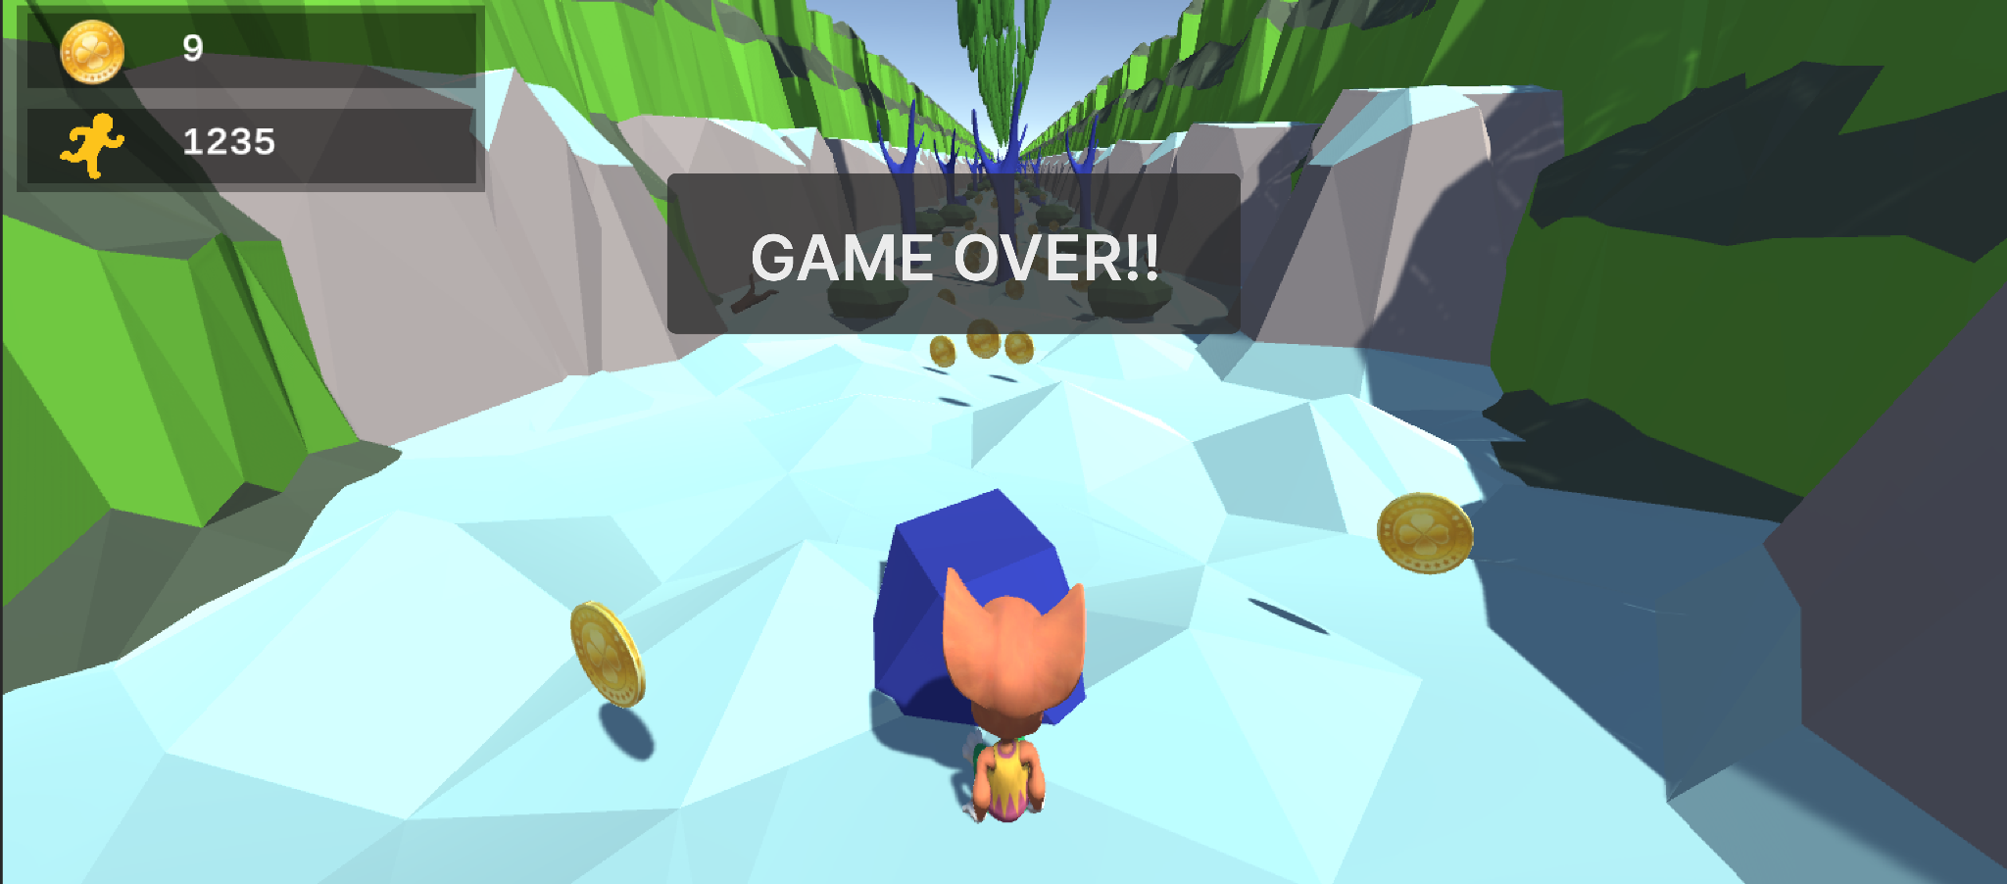

Slide 12
Technology:
Unity
C#

